Slide 1





Accident Prediction
Team : Adapa Uma Siva Sankar Korimi Venkata Sai Naveen Korada Ganesh SSVP
Guide: Saomya Chaudhry
Disclaimer: The content is curated for educational purposes only.

Slide 2


Analysis and Prediction of
Road Accident Severity in India
This presentation explores a machine learning solution to predict the severity of road accidents in India, using real-world data and predictive models.

Slide 3
Abstract: Road Accident Severity Prediction
Objective
Analyze historical road accident data
Predict severity (minor, major, fatal)
Scope
Help authorities prioritize resources
Implement preventive measures

Slide 4

Problem Statement : Road Accident Crisis
Context
- High road accident rates globally
Challenge
- Lack of systematic severity
prediction
Need
- Predictive system for resource
allocation
- Over 150,000 fatalities annually

Slide 5





Proposed Solution: A Data- Driven Approach
Data Collection
- Historical accident data (govt. databases)
Data Preprocessing
- Handle missing values, outliers, normalization
- Weather, road conditions, vehicle type
Model Development
- Train models (e.g., Logistic
Regression, Random Forest)
Deployment
- Dashboard or mobile app for real-
time predictions

Slide 6




System Architecture: A Layered Approach
Data Layer
- Historical accident, weather, and road condition data
1
Preprocessing Layer
- Data cleaning, feature engineering, normalization
2
Model Layer
- Machine learning models for severity classification
3
Application Layer
- Web or mobile interface for user predictions
4

Slide 7
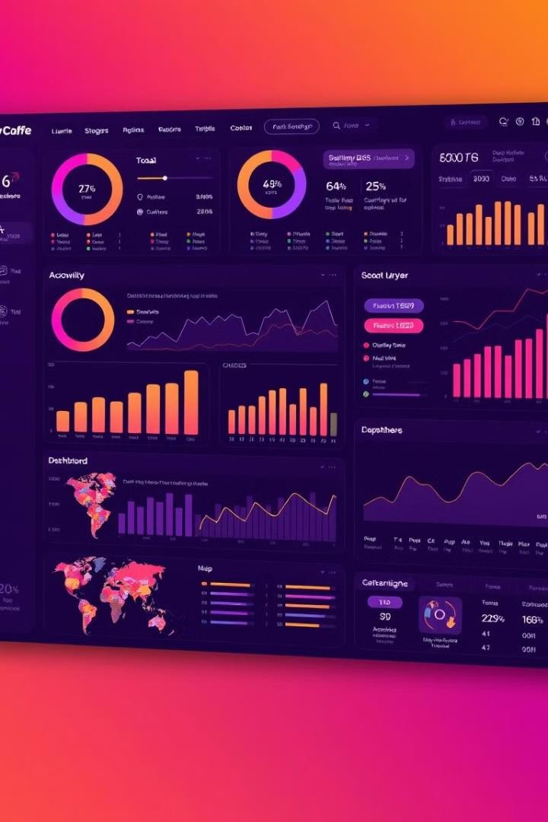
Live Demo: Real-Time Severity Prediction
1
Severity Prediction
- Real-time classification (minor, major, fatal)
2
Heatmaps
- Visualize high-severity accident zones
3
Alerts
- Notifications for high-risk areas

Slide 8
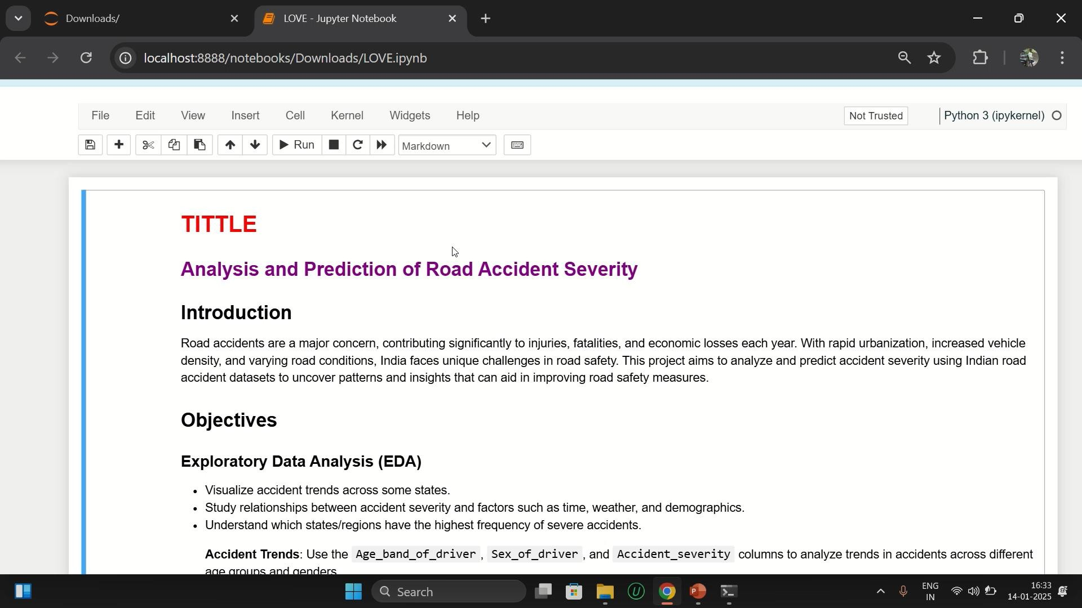

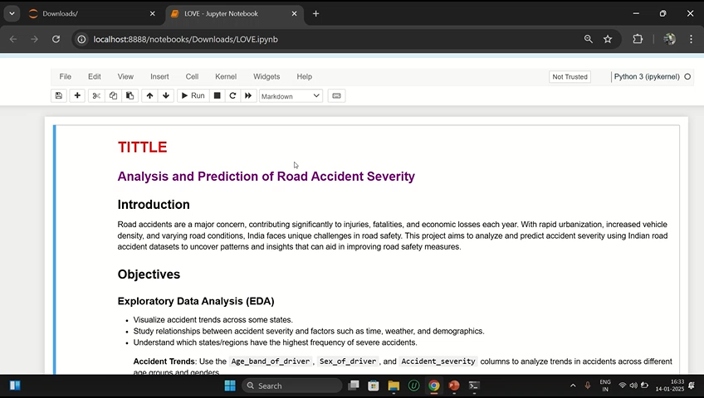
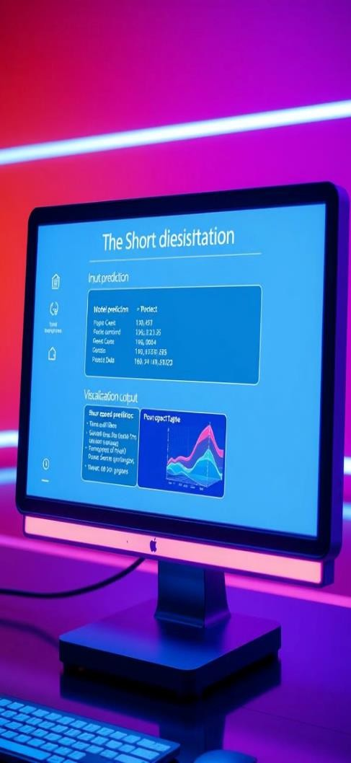

Slide 9
Conclusion: Road Safety Through Data
Summary
- Developed a machine learning model for road accident severity prediction
1
Impact
- Helps authorities prioritize resources and take preventative measures
2
Challenges
- Data quality, imbalanced datasets, real-time data integration
3

Slide 10

Future Scope: Expanding the System
1
Integration with IoT
- Real-time data from traffic cameras and sensors
2
Mobile App Development
- Create a mobile app for
drivers and authorities
3
Government Collaboration
- Partner with agencies for large-scale implementation
4
Advanced Models
- Explore deep learning models for improved accuracy

Slide 11

Thank You!
- Acknowledgements to the guide and team members

